Slide 1
PF Integration (Site) Overview
Last Update: 2026/2/16

Slide 2
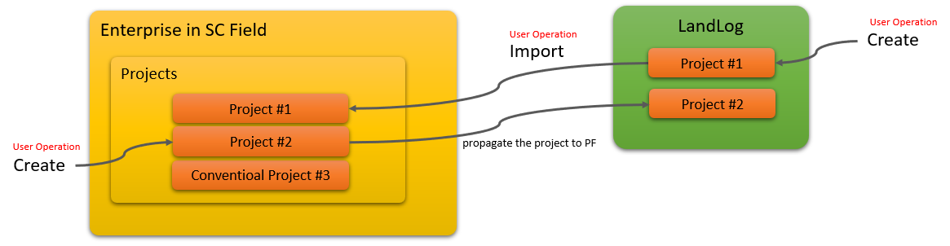
The concept of PF Site Integration.
The effect of project related operation in SC Field/Office conventionally was limited within SC Field/Office only, because projects were not synchronized(associated) with other Earthbrain SC Solutions. Hence, EBJ promotes interconnectivity between other solutions by passing data through LandLog / Platform.
Once the PF Site integration feature is released, the project creation/edit feature will change as follows.
(1) If you create a new project in SC Field/Office, the same project is automatically created in LandLog PF too (which make it possible to share the project with other SC Products)
(2) You can import a project created in LandLog PF to SC Field/Office.
(3) If a project is edited in either of LandLog PF or SC Field/Office, that is synced with the other.
(4) If a project is deleted/archived/transported, the project is inactivated in SC Field/Office.

Slide 3
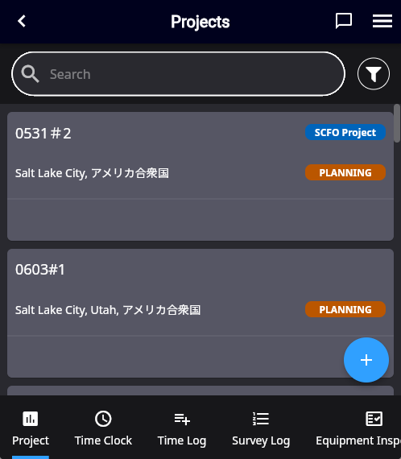
The concept of PF Site Integration
Note that not all the projects in SC Field/Office are linked with PF.
Conventional projects (projects created before the PF integration release) and some projects created in SC Office (refer to SC Office section in this document) are excluded and will not be linked with PF projects.
However, regardless of whether a project is being linked with PF, there is no difference in the UX for each feature in a project.
On the project list screen,
conventional projects will be tagged with “SCFO Project”.
A project created after the PF integration release will be linked with PF project and will not receive this tag.

Slide 4
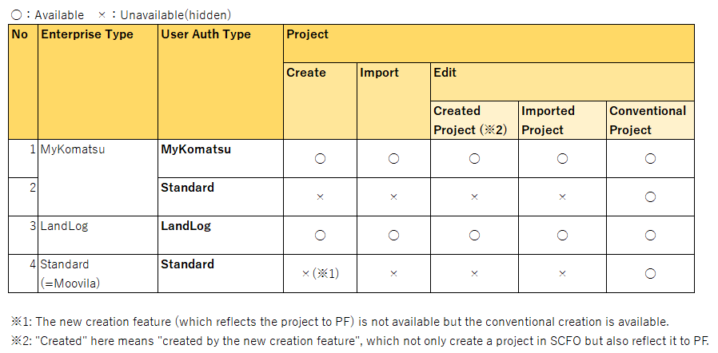
Availability of Project related features
After PF integration is released, the ability to create/import/edit projects varies by company-type/user-type as follows:
Standard authenticated users cannot use features requiring integration with LL (subject in this new release) because they do not have an LL account. The premise is that the user requires authentication with LandLog in order to integrate with LandLog. Hence, Standard users can only create conventional SCFO Projects.

Slide 5
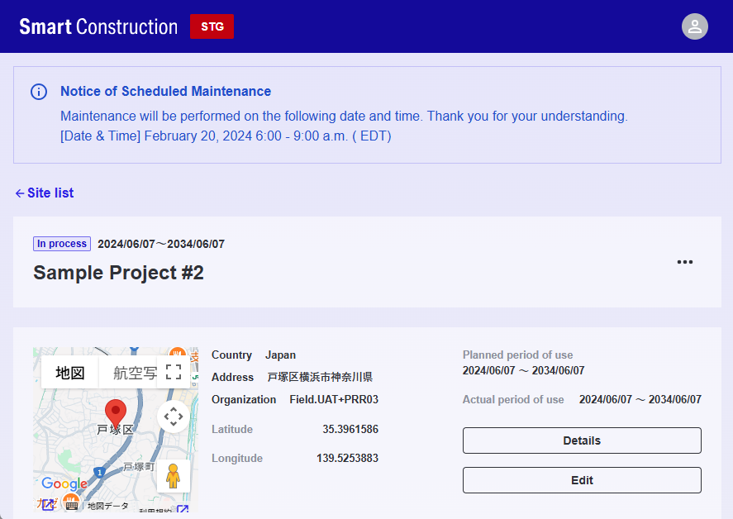
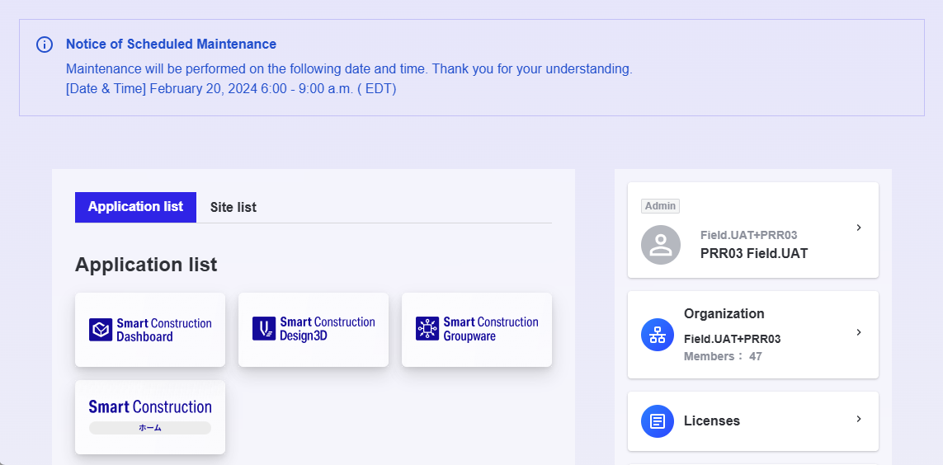
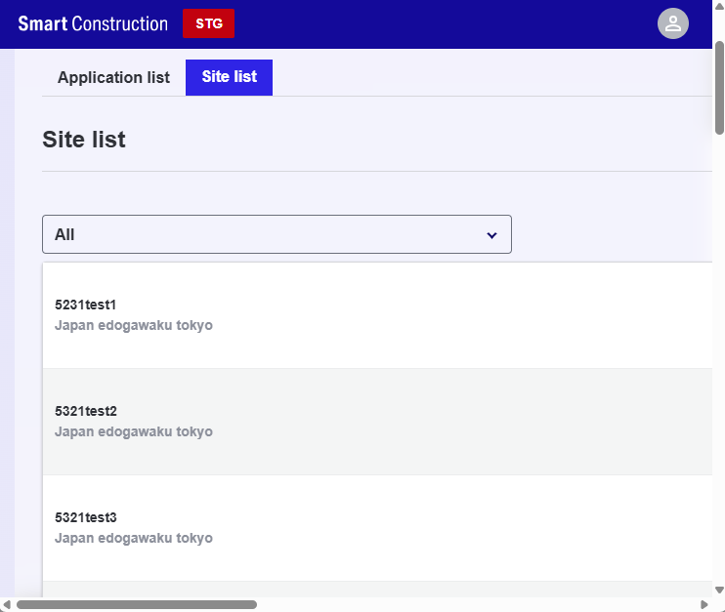
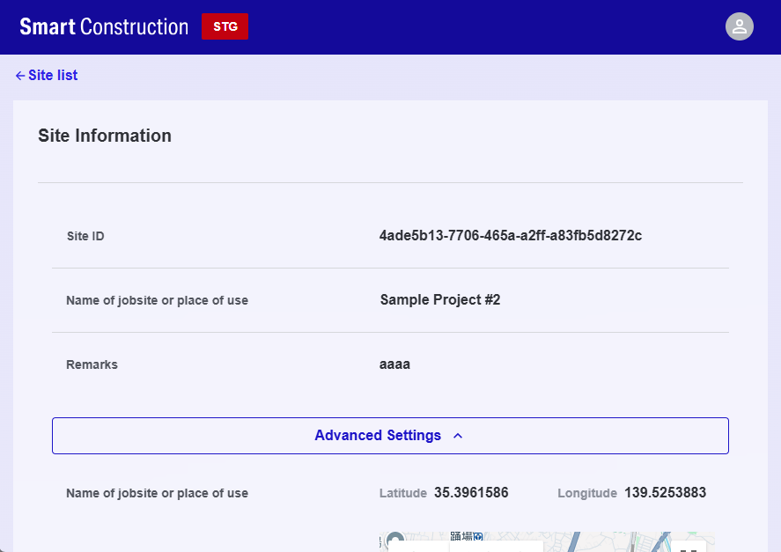
Projects in LandLog PF
Projects created or imported in SC Field/Office (i.e., projects linked with LandLog PF) can be viewed in detail and edited in LandLog PF as follows:

Slide 6
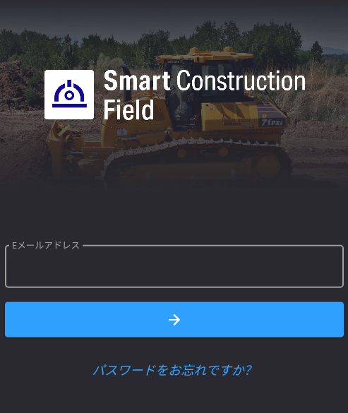
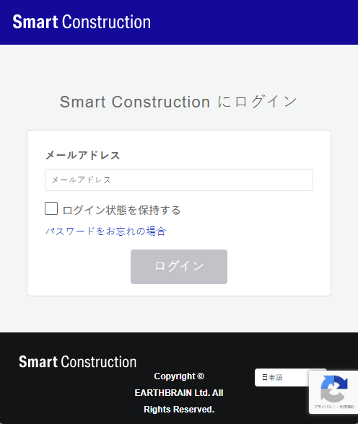
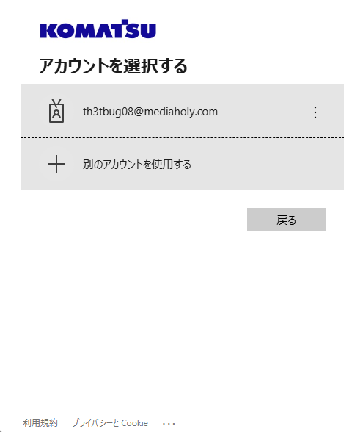
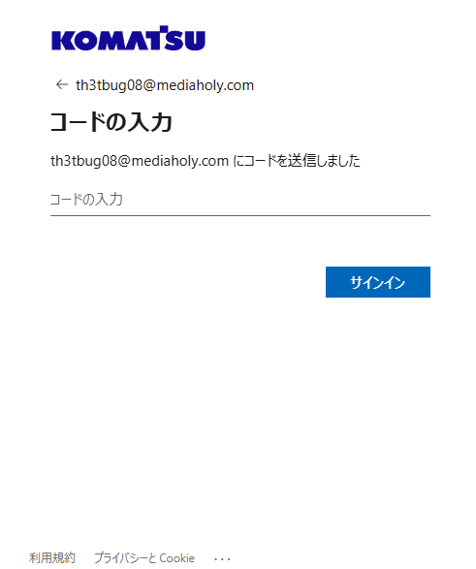
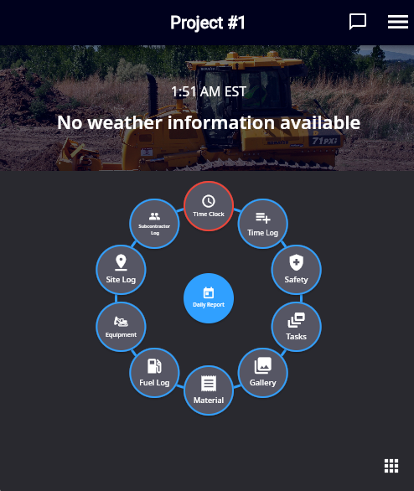
Login flow (MyKomatsu authentication users)
As a result of PF integration, the login screen transition for MyKomatsu authentication users will be as follows:
※Standard authentication users and LandLog authentication users remain the same.
※It goes through LandLog authentication screen so that the user can utilize LandLog APIs for PF integration features.
Enter E-mail address.
Enter E-mail address.
Select your account.
Enter a code sent to the E-mail address.

Slide 7
User Operation
(SC Field)

Slide 8
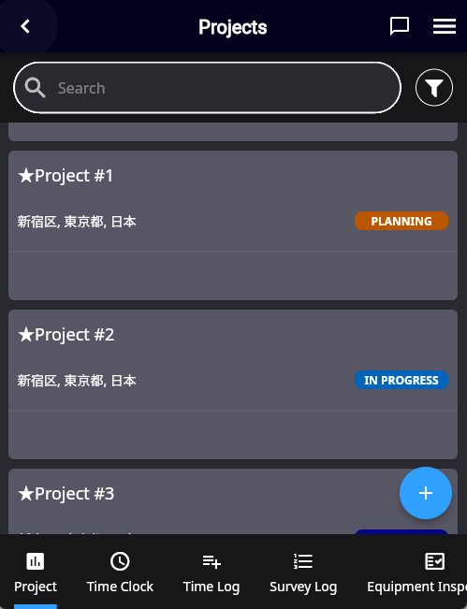
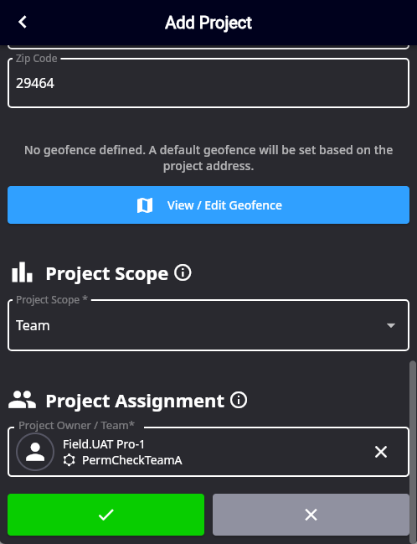
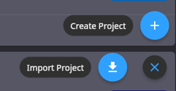
Project creation flow
The UI flow for creating projects remains the same as before.
Newly created projects are automatically reflected in LandLog PF and become linked between SC Field/Office and LandLog PF.
Project creation is performed from “Create Project” in the Project screen. After entering the project details and saving the project, the project will be linked with LandLog PF.

Slide 9
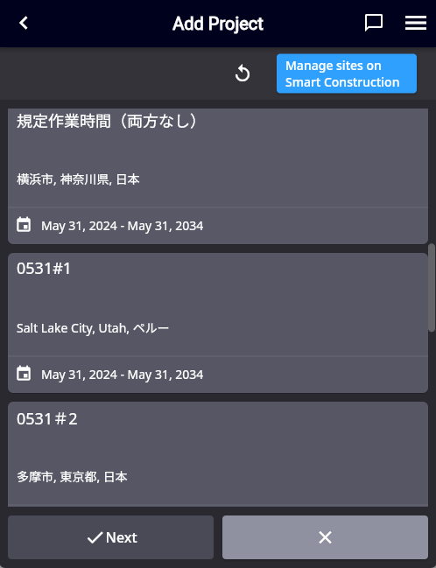
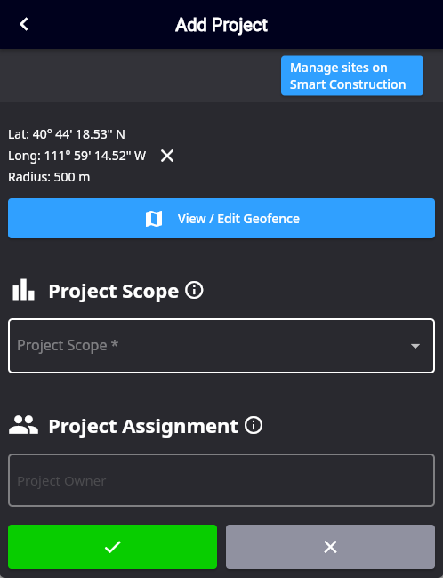
Project import flow
Projects existing only in LandLog can be imported as follows.
Imported projects will be linked between SC Field/Office and LandLog PF.
Select “Import Project”.
All the available projects in LandLog PF are shown.
Select a project to import, then press “Next”.
Edit the project detail as needed then press “✓”.

Slide 10
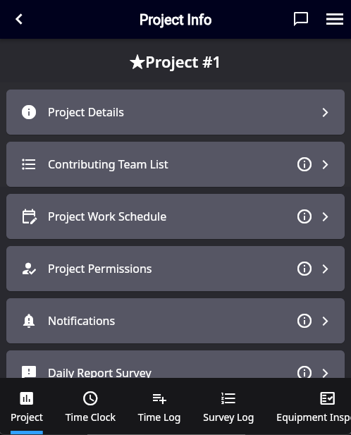
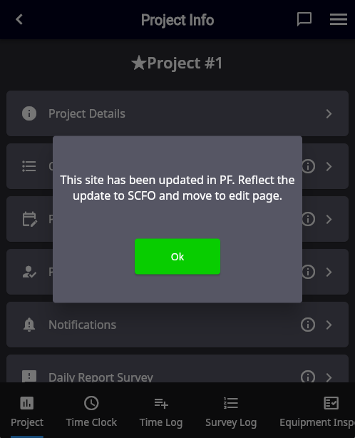
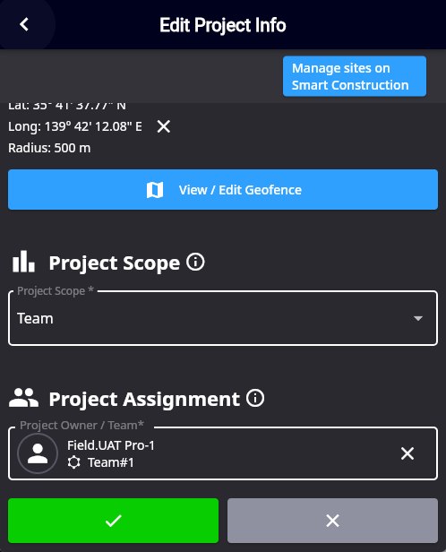
Project edit flow
The UI flow for editing projects remains the same. However, it will automatically retrieve the project information from LandLog PF before editing (displaying a message to that effect).
Edits will be automatically reflected in the project on LandLog PF.
The same holds true when the project information is updated in SCFO and synced to LandLog PF.
If any update on details of the project on PF side, that is automatically reflected when opening the edit screen.

Slide 11
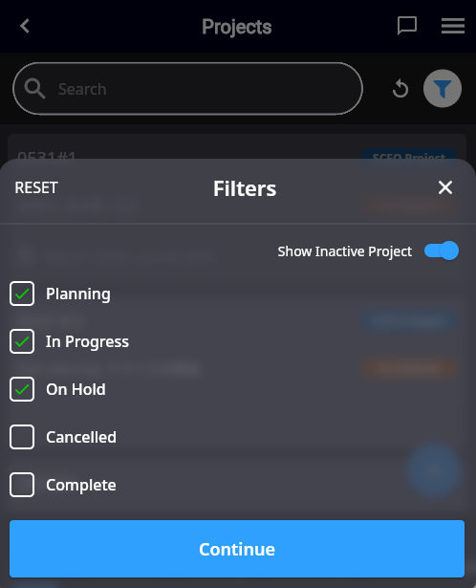
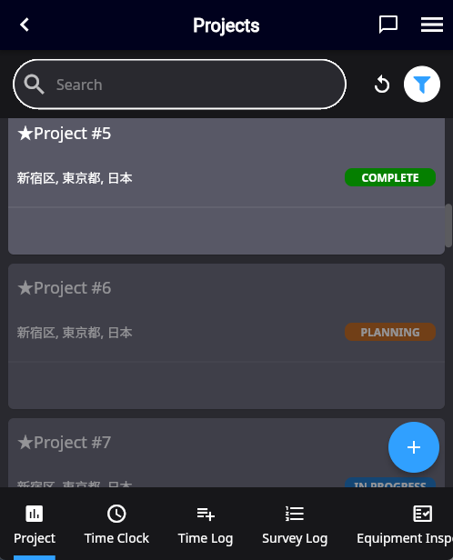
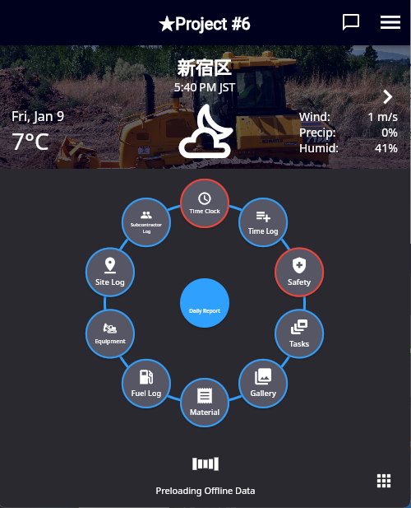
Project deletion flow (1)
When a project linked to PF is deleted/transferred/archived on the LandLog side, that project will be automatically deactivated on the SC Field/Office side after a set period of time.
However, you can still select it by choosing “Show Deactivated Projects” in the project list, and you can still create and view various records within that project.
When a project is deleted from SCFO, that project will only be set as inactive and will not reflect to the project stored in LandLog PF. This is to avoid accidental project deletion that are linked to other SC Solutions.
Inactivated Projects are grayed out but still selectable.

Slide 12
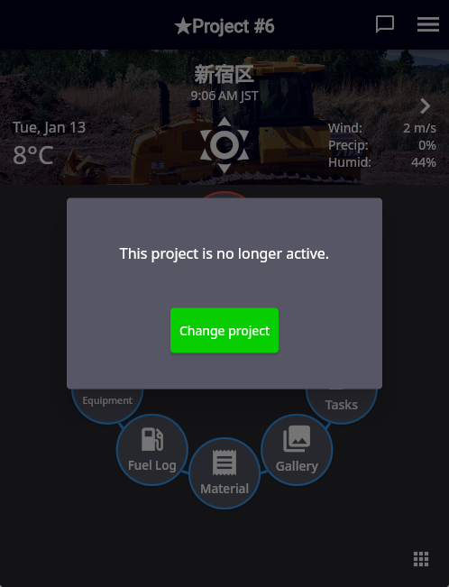
Project deletion flow (2)
If a project is deleted/transferred/archived on LandLog PF and that is reflected to SC Field/Office, a users will see following message when he logs in SC Field (only when the default project is the deleted project) or transit to project detail screen of the deleted project.
By pressing “Change Project”, screen transits to Project select screen, where the user can select an active project.

Slide 13
User Operation
(SC Office)

Slide 14
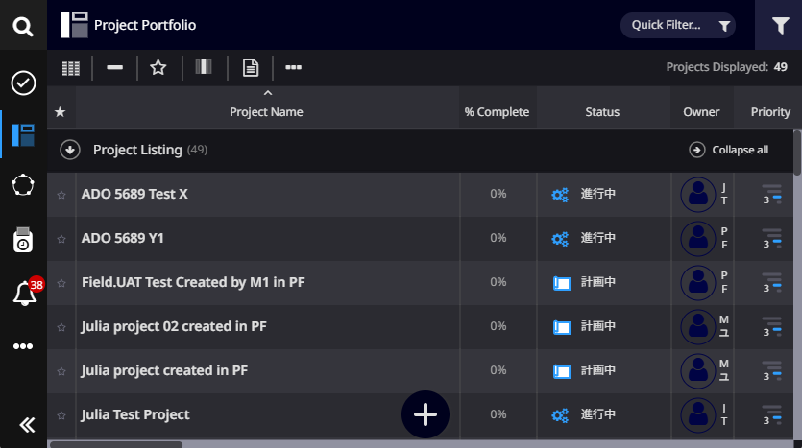
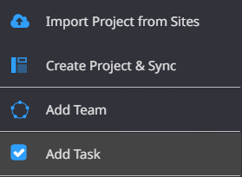
Project creation flow (1)
Select “Create Project & Sync” in “+” menu.

Slide 15
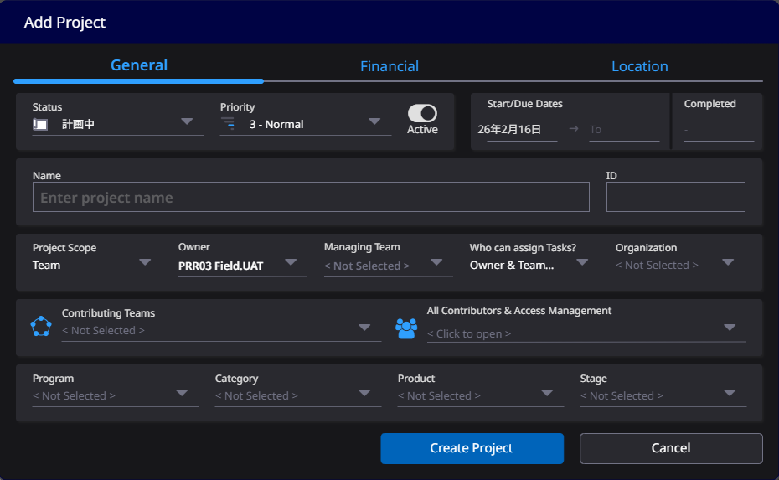
Project creation flow (2)
Fill out fields and press save. Then, the project is created not only in SCFO but also in Landlog Platform, which mean the project (in SC Field/Office) is linked with the corresponding project in Landlog Platform.

Slide 16
Project import flow (1)
Select “Import Project from Sites” in “+” menu.

Slide 17
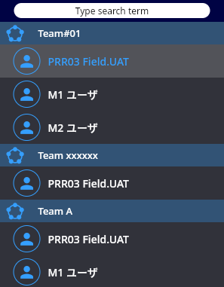
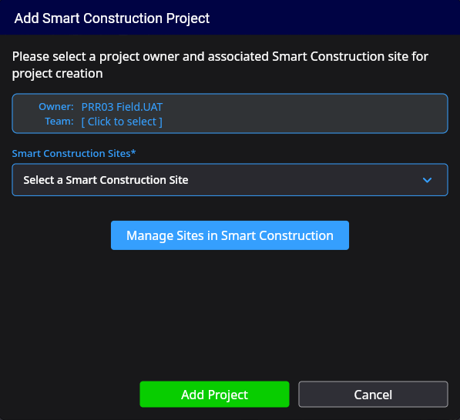
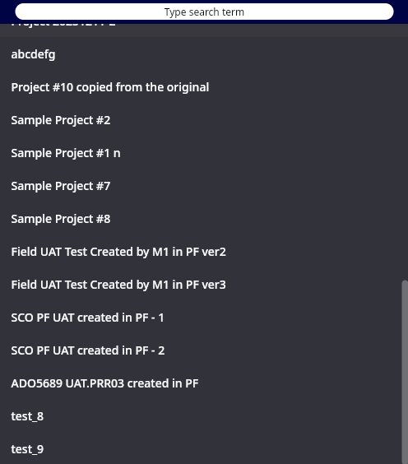
Project import flow (2)
Select the owner & team of the project, select target project, and press “Add Project”.
Then the project is imported to SC Field/Office.
This button opens Landlog Platform where you can create/edit/delete sites.

Slide 18
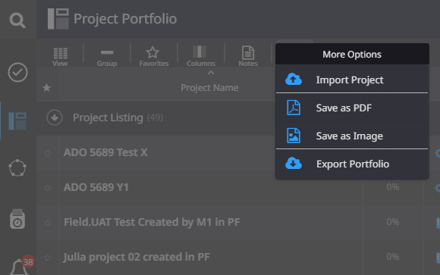
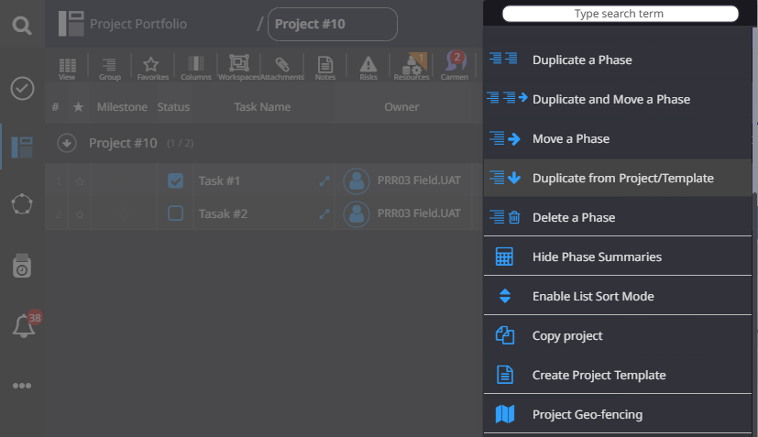
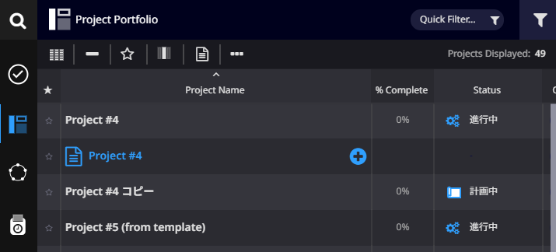
Other ways to create a project in SC Office
There are other ways to create projects in SC Office.
Note that not all of them support link with Landlog Platform.
Operation | Link with LandLog | Notes
Copy Project | ○
Create a project from a template | ○
Create template from a project | × | Template is not a project.
Import MS project | ×
Import MS Project
Create a project from a template
Copy Project
Create template from a project

