Slide 1
PF Integration (Equipment) Overview
Last Update: 2026/2/16

Slide 2
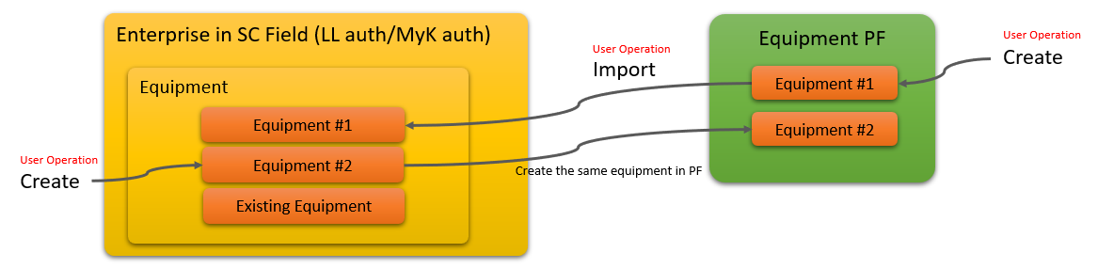
The concept of PF Site Integration.
The effect of equipment related operation in SC Field/Office conventionally was limited within SC Field/Office only, because equipment was not synchronized(associated) with other Earthbrain SC Solutions. Hence, EBJ promotes interconnectivity between other solutions by passing data through LandLog / Platform.
Once the PF Equipment integration feature is released, the equipment creation/edit feature will change as follows.
(1) If you create a new piece of equipment in SC Field/Office, the same piece is automatically created in Equipment PF too (which makes it possible to share the piece with other SC Products)
(2) You can import equipment created in LandLog PF to SC Field/Office.
(3) When equipment is edited in either of LandLog PF or SC Field/Office, that is synced with the other.
(4) When equipment is deleted/archived/transported, the project is inactivated in SC Field/Office.

Slide 3
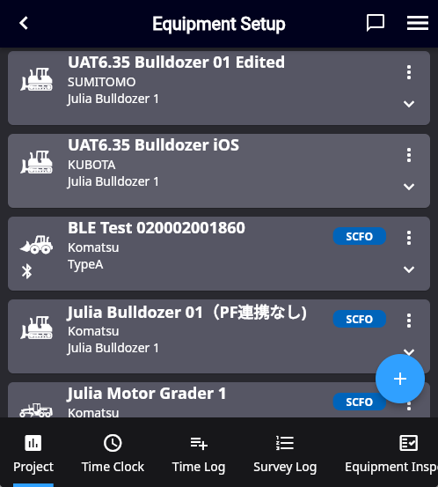
The concept of PF Equipment Integration
Note that not all the pieces of equipment in SC Field/Office are linked with PF.
Conventional pieces (the ones created before the PF integration release) and some created in SC Office (refer to SC Office section in this document) are excluded and will not be linked with PF equipment.
However, regardless of whether a piece is being linked with PF, there is no difference in the UX in each SC Field feature.
In the Equipment setup screen,
conventional equipment will be tagged with “SCFO Project”.
The ones created after the PF integration release will be linked with PF equipment and will not receive this tag.

Slide 4
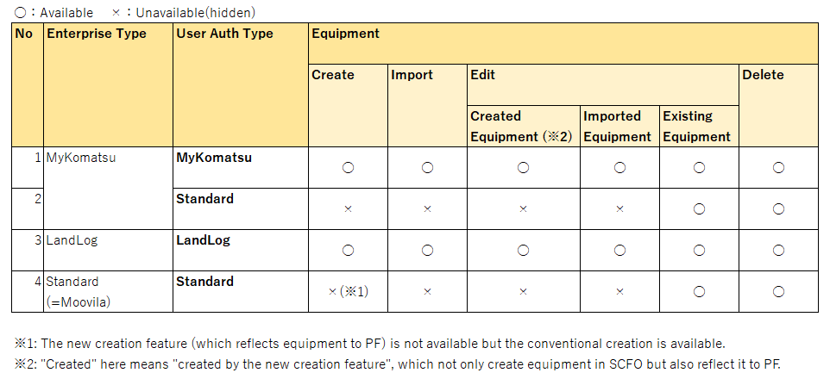
Availability of Equipment related features
After PF integration is released, the ability to create/import/edit equipment varies by company-type/user-type as follows:
Standard authenticated users cannot use features requiring integration with LL (subject in this new release) because they do not have an LL account. The premise is that the user requires authentication with LandLog in order to integrate with LandLog. Hence, Standard users can only create conventional SCFO Projects.

Slide 5
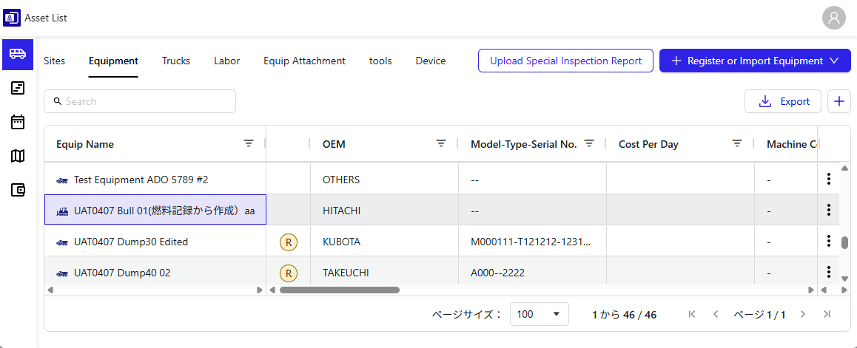
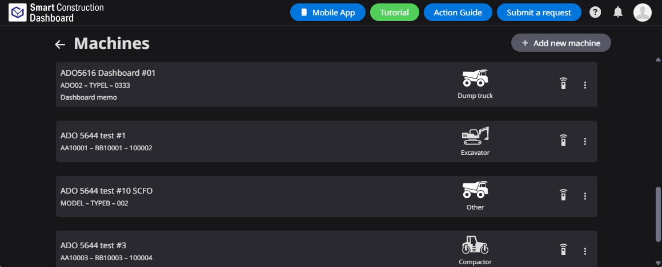
Equipment in Equipment PF
Equipment created or imported in SC Field/Office (i.e., projects linked with LandLog PF) can be viewed in SC Whiteboard as follows:
SC Whiteboard
SC Dashboard

Slide 6
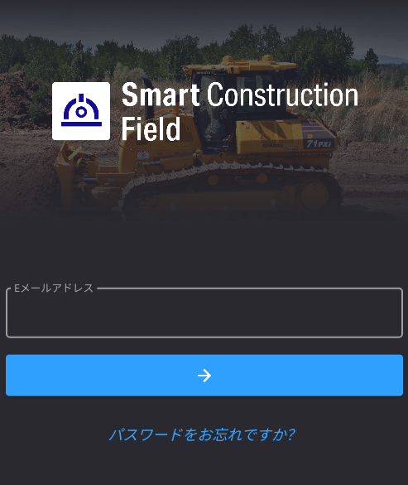
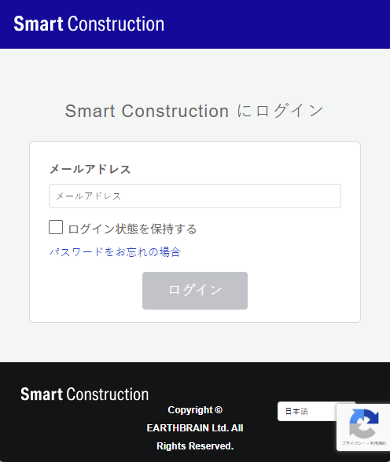
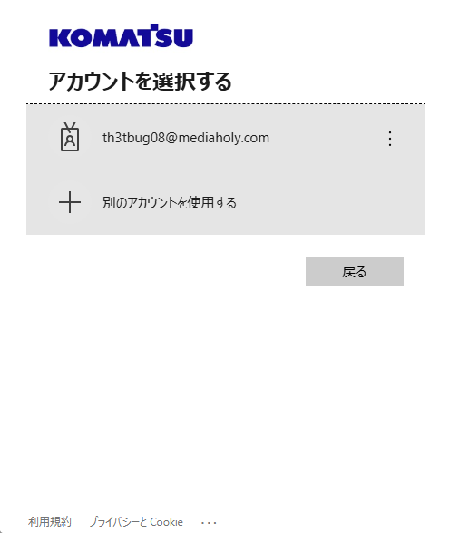
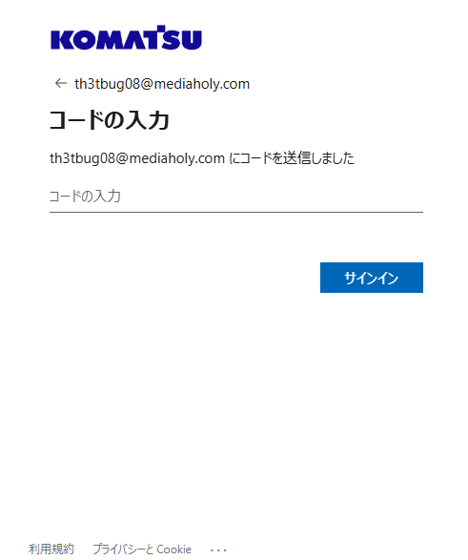
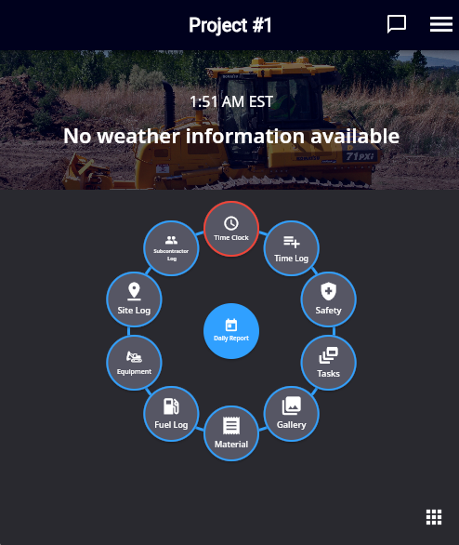
Login flow (MyKomatsu authentication users)
As a result of PF integration, the login screen transition for MyKomatsu authentication users will be as follows:
※Standard authentication users and LandLog authentication users remain the same.
※It goes through LandLog authentication screen so that the user can utilize LandLog APIs for PF integration features.
Enter E-mail address.
Enter E-mail address.
Select your account.
Enter a code sent to the E-mail address.

Slide 7
User Operation
(SC Field)

Slide 8
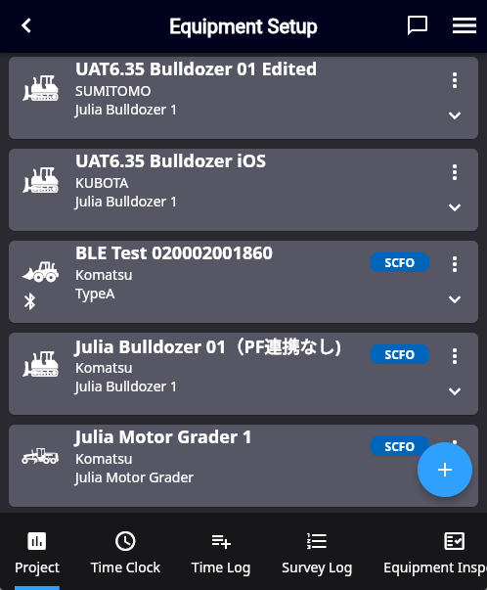
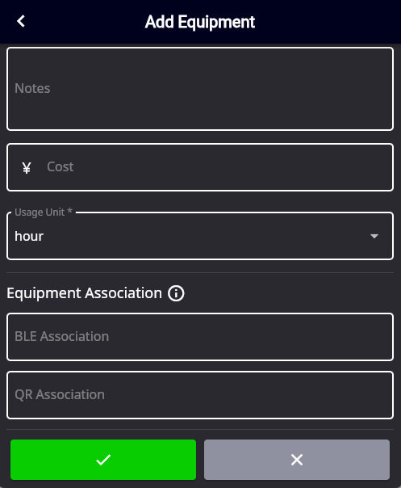
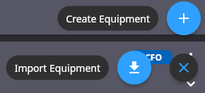
Equipment creation flow
The UI flow for creating equipment remains the same as before.
Newly created equipment is automatically reflected in LandLog PF and become linked between SC Field/Office and LandLog PF.
Equipment creation is performed from “Create Equipment” in the Equipment Setup screen. By entering the equipment details and pressing “✓”, it is linked with LandLog PF.

Slide 9
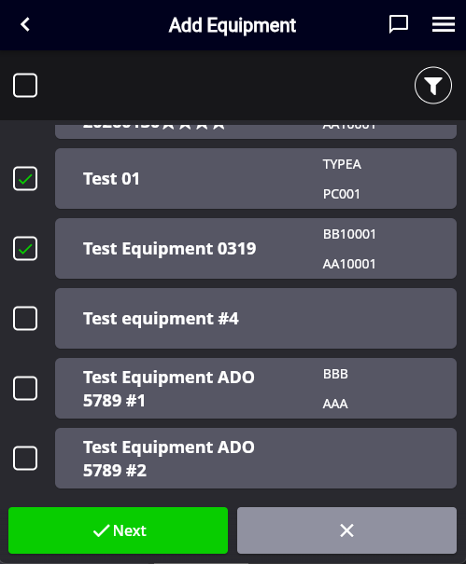
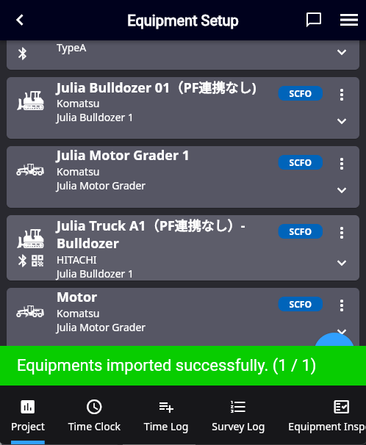
Equipment import flow
Equipment existing in Equipment PF can be imported as follows.
Imported equipment will be linked between SC Field/Office and Equipment PF.
Select “Import Equipment”.
All the available pieces in Equipment PF are shown.
Select a piece to import, then press “Next”.
The imported piece appears in the Equipment Setup screen.

Slide 10
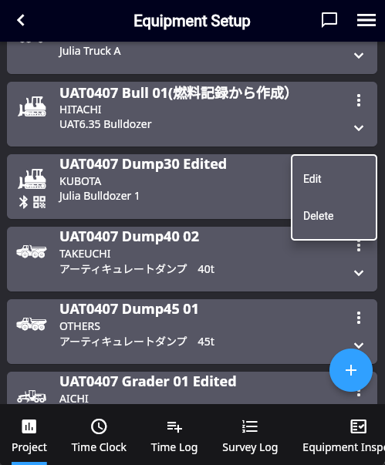
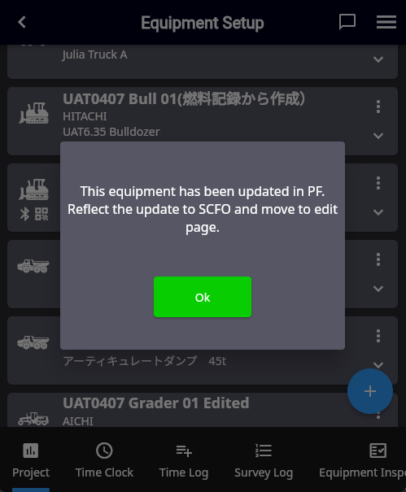
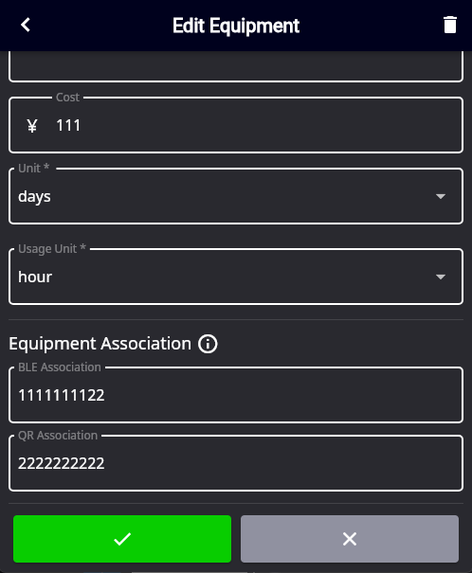
Equipment edit flow
The UI flow for editing equipment remains the same. However, it will automatically retrieve the equipment information from Equipment PF before editing (displaying a message to that effect).
Edits will be automatically reflected to the corresponding equipment on Equipment PF.
The same holds true when the equipment information is updated in SCFO and synced to LandLog PF.
If any update on details of the equipment on PF side, that is automatically reflected when opening the edit screen.

Slide 11
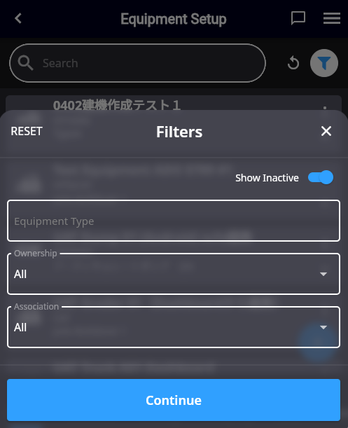
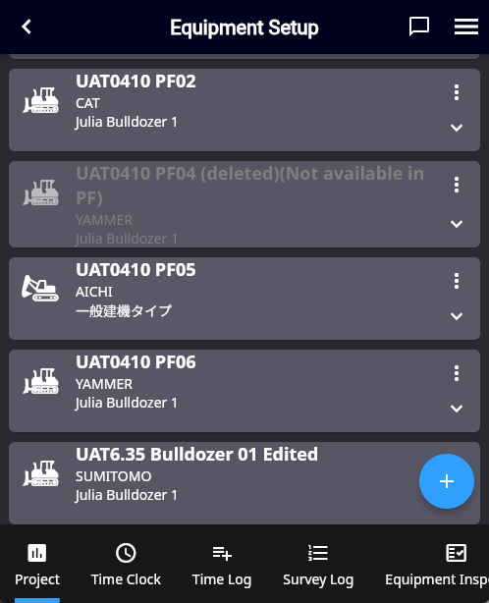
Equipment deletion flow (1)
When equipment linked to PF is deleted on the Equipment PF side, that equipment will be automatically deactivated on the SC Field/Office side after a set period of time.
However, you can still select it by choosing “Show Deactivated” in the equipment list, can also utilize the equipment in SC Field/Office.
When equipment is deleted from SCFO, that is not reflected to Equipment will only be set as inactive and will not reflect to the project stored in LandLog PF. This is to avoid accidental project deletion that are linked to other SC Solutions.
Inactivated equipment is grayed out but still visible.

Slide 12
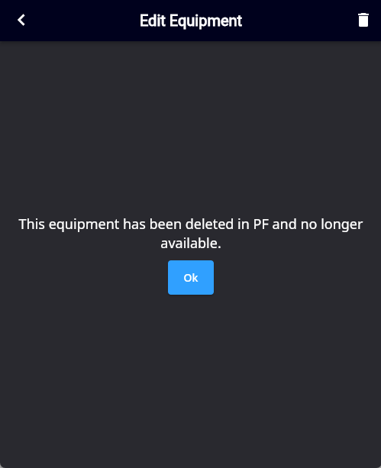
Equipment deletion flow (2)
If equipment is deleted on Equipment PF, a users will see following message when he enters equipment edit screen in SC Field.
By pressing “OK”, screen transits to Equipment Setup screen.

Slide 13
User Operation
(SC Office)

Slide 14
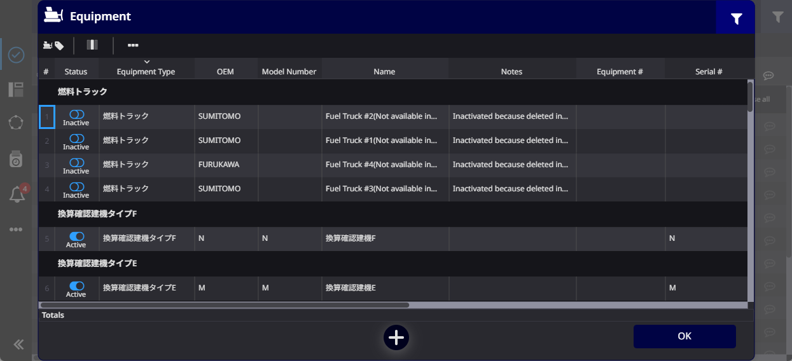
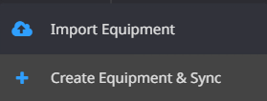
Project creation flow (1)
Open Equipment Admin modal and select “Create Equipment & Sync” in “+” menu.

Slide 15
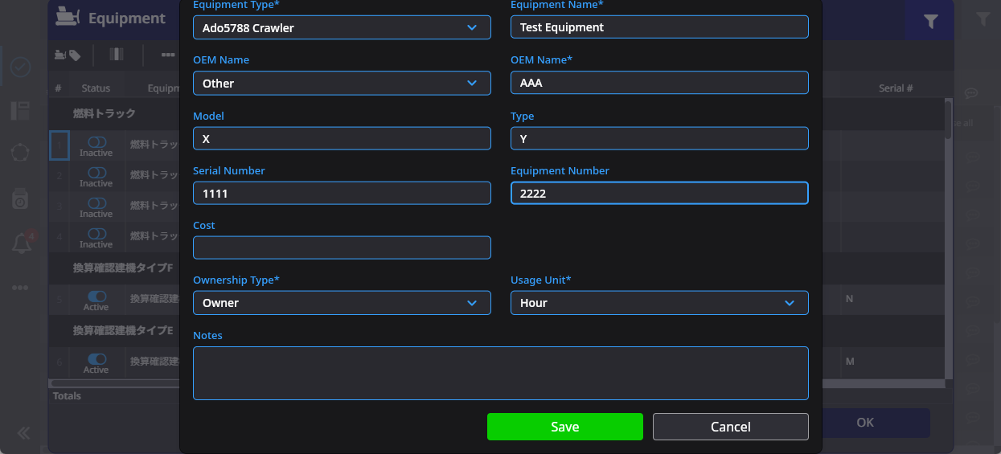
Equipment creation flow (2)
Fill out fields and press save. Then, the equipment is created not only in SCFO but also in Equipment PF, which mean the equipment (in SC Field/Office) is linked with the corresponding project in Equipment PF.

Slide 16
Project import flow (1)
Open Equipment Admin modal and select “Import Project from Sites” in “+” menu.

Slide 17
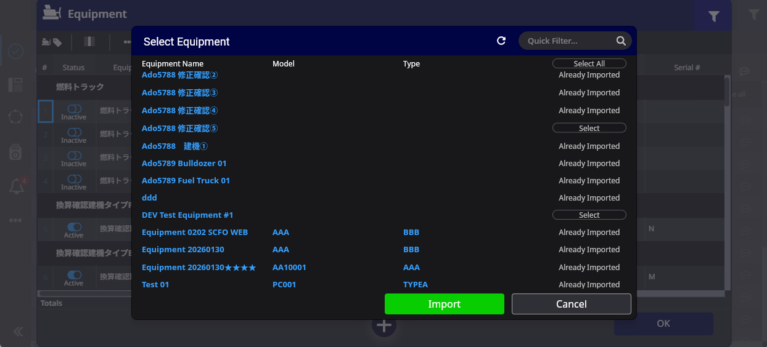
Project import flow (2)
Select the pieces of equipment you want to import and press “Import”.
Then those are imported to SC Field/Office.

